Slide 2
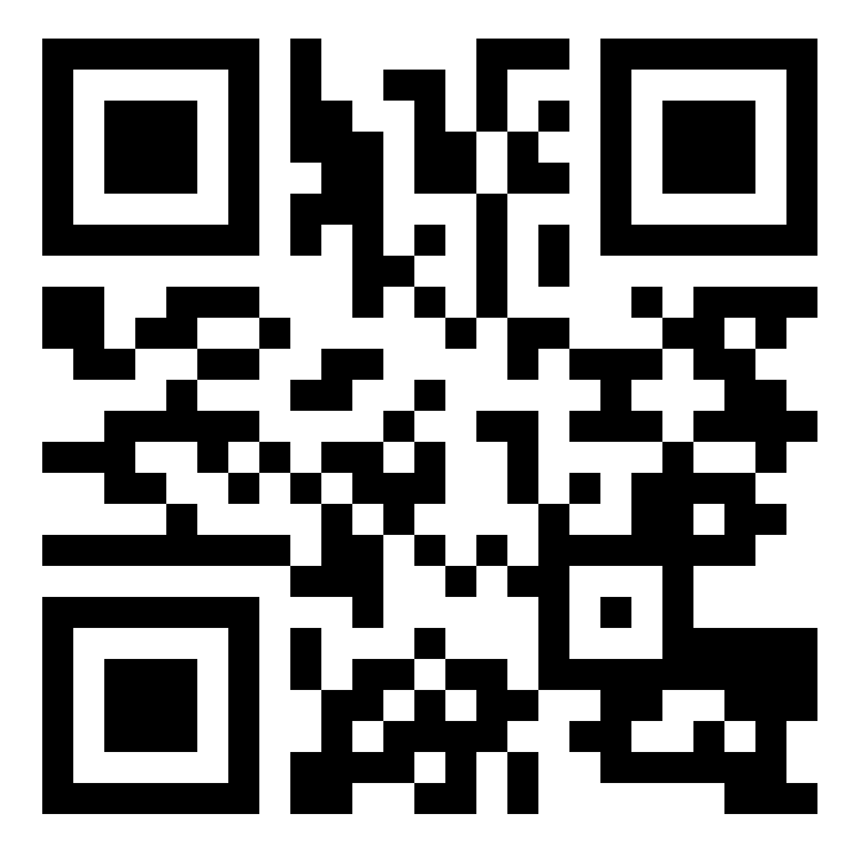
Create 'no code' solutions with SharePoint
BRK3080
Cyrus Balsara
Group Engineering Manager – SharePoint
Robert Chen
Engineering Manager – SharePoint
Dan Stanciu
Engineering Manager - SharePoint
https://aka.ms/brk3080

Slide 3
About us
Developers in the SharePoint Experiences team
We make experiences for
Sites
Document Libraries
Lists
Biz Apps
And more..
Our recently released features include
Hub Sites,
Site scripts,
Microsoft Flow and PowerApps integration,
View Formatters
and more

Slide 4
What is this session about?
If you’re a savvy SharePoint user, you’re in the right place
It’ll show you ways to make applications and solutions on SharePoint
With custom business logic and
Custom UI
With little to no code
We’ll walk through the creation of a full solution with you today

Slide 5
Cheat Sheet
https://aka.ms/brk3080
GitHub repo with project details

Slide 6
So, what are we going to make?
A classroom application
Why?
Easy to understand
Lots of opportunity for custom business logic and custom UX
Shows off capabilities to “package” up your solution and stamp it out again and again

Slide 7
Demo

Slide 8
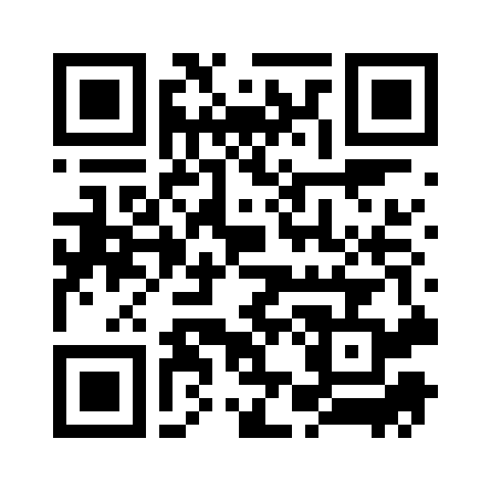
Please evaluate this session Your feedback is important to us!
This slide is required. Do NOT delete or alter the slide.
The slide will be replaced onsite through Silver Fox Productions with an updated QR code.
From your PC or Tablet visit MyIgnite at http://myignite.microsoft.com
From your phone download and use the Ignite Mobile App by scanning the QR code above or visiting https://aka.ms/ignite.mobileapp

